Slide 1
Topic Modeling
Extracted from this notebook HTML

Slide 2
Project Overview
Goal: Discover latent topics in unlabeled documents
Unsupervised NLP with probabilistic modeling
Outputs: Topics (top words) + document-topic distribution

Slide 3
Steps
Clean text (lowercase, remove punctuation/stopwords)
Vectorize (Count, TF‑IDF)
Fit LDA to discover topics
Evaluate with coherence & perplexity (if shown)
Visualize top words + topic distribution

Slide 4
Method
Model: Latent Dirichlet Allocation (LDA)
Features: CountVectorizer and TF‑IDF
Preprocessing: lowercasing, digits/punctuation removal, stopwords

Slide 5
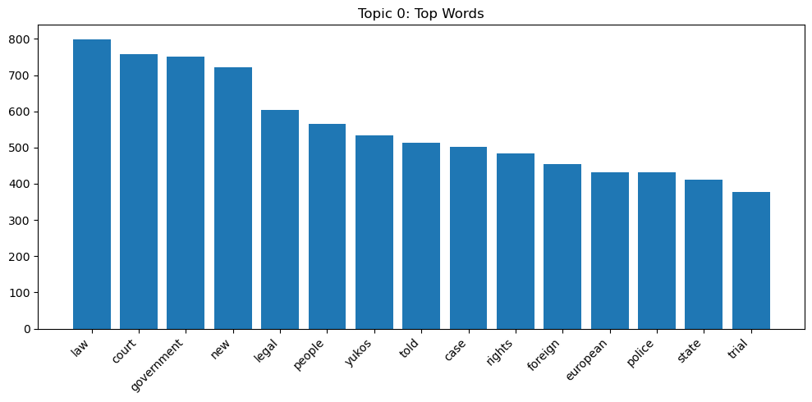
Visualization

Slide 6
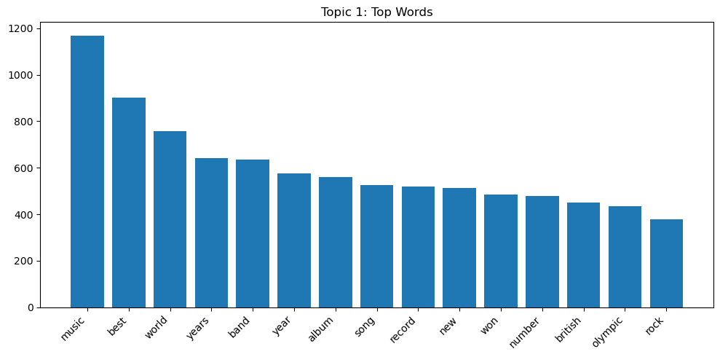
Visualization 2

Slide 7
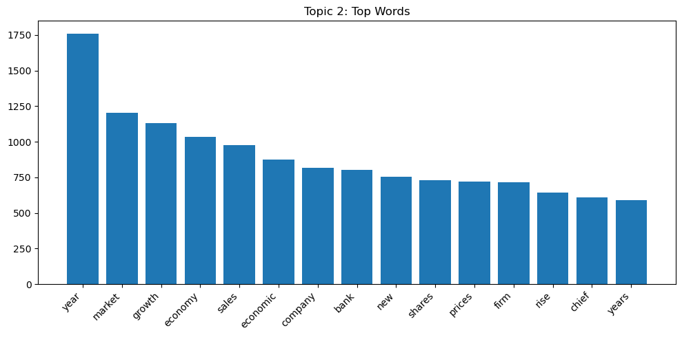
Visualization 3

Slide 8
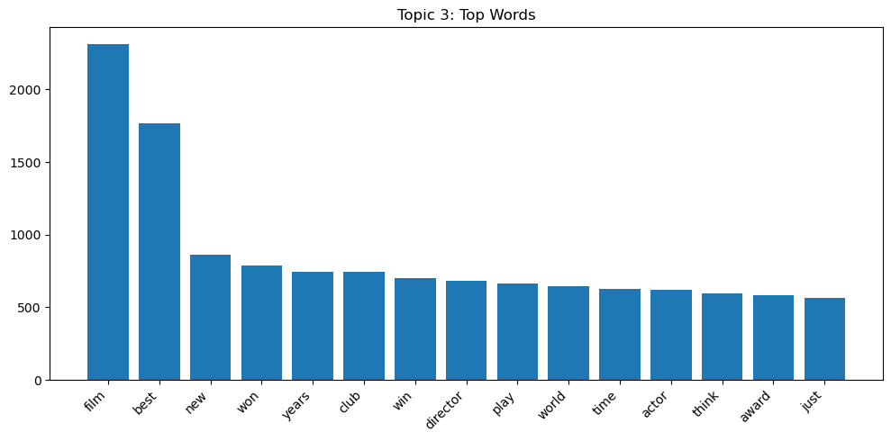
Visualization 4

Slide 9
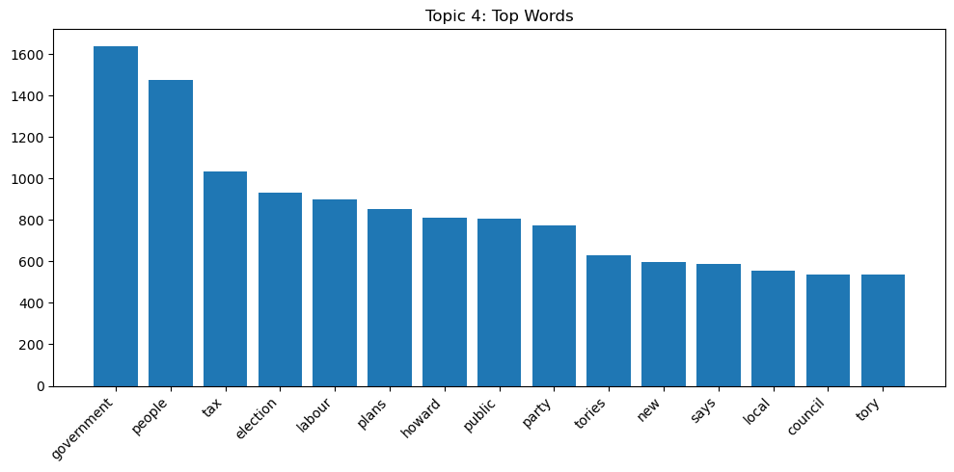
Visualization 5

Slide 10
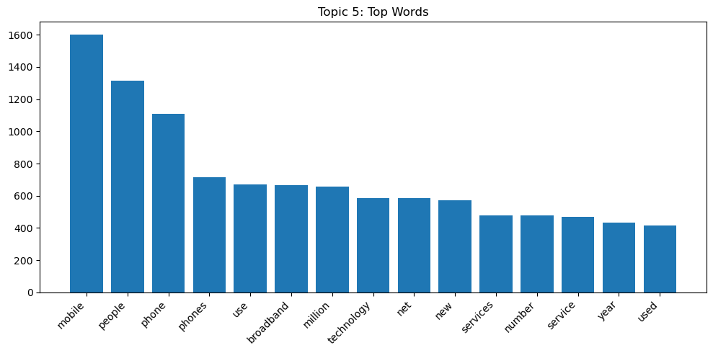
Visualization 6

Slide 11
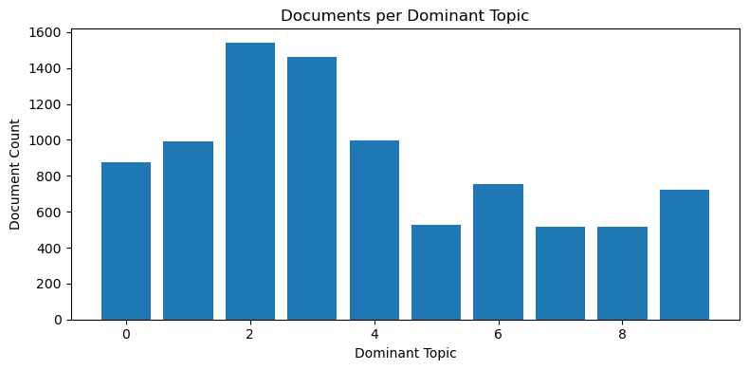
Visualization 7

Slide 12
Conclusion
LDA reveals coherent topics via top words
Figures reused directly from the notebook
All numbers and visuals come from this HTML only

